Slide 1
Knowledgebase Representation
Fuzzy Expert Systems

Slide 2
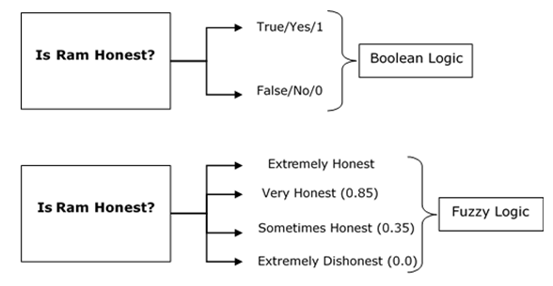
What is Fuzzy Logic?
The word fuzzy refers to things which are not clear or are vague. Any event, process, or function that is changing continuously cannot always be defined as either true or false, which means that we need to define such activities in a Fuzzy manner.
Fuzzy logic is based on the idea that all things admit of degrees. Temperature, height, speed, distance, beauty, all come on a sliding scale.

Slide 3
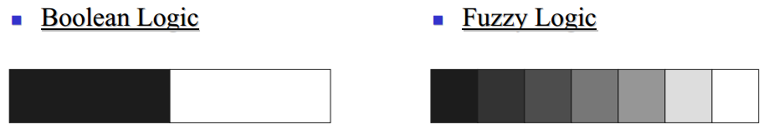
Fuzzy logic
Fuzzy logic is a set of mathematical principles for knowledge representation based on degrees of membership
Unlike two-valued Boolean logic, fuzzy logic is multi-valued. It deals with degrees of membership and degrees of truth.
Fuzzy logic uses the continuum of logical values between 0 (completely false) and 1 (completely true). Instead of just black and white, it employs the spectrum of colours, accepting that things can be partly true and partly false at the same time.

Slide 4
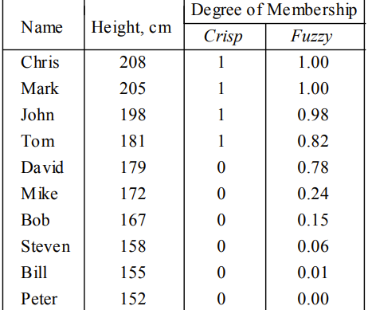
Fuzzy logic
The elements of the fuzzy set “tall men” are all men, but their degrees of membership depend on their height.

Slide 5
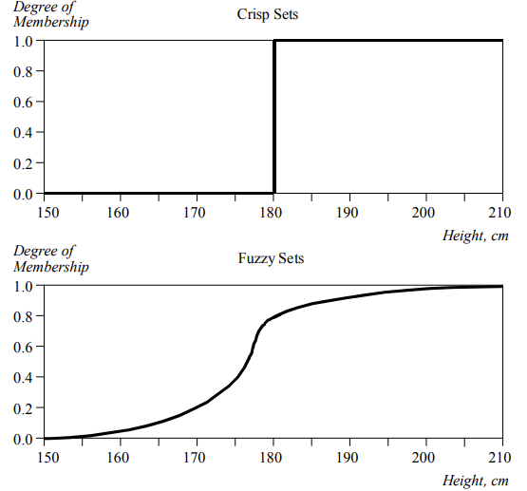
Crisp and fuzzy sets

Slide 6
Crisp and fuzzy sets
The x-axis represents the universe of discourse − the range of all possible values applicable to a chosen variable. In our case, the variable is the man height. According to this representation, the universe of men’s heights consists of all tall men.
The y-axis represents the membership value of the fuzzy set. In our case, the fuzzy set of “tall men” maps height values into corresponding membership values.

Slide 7
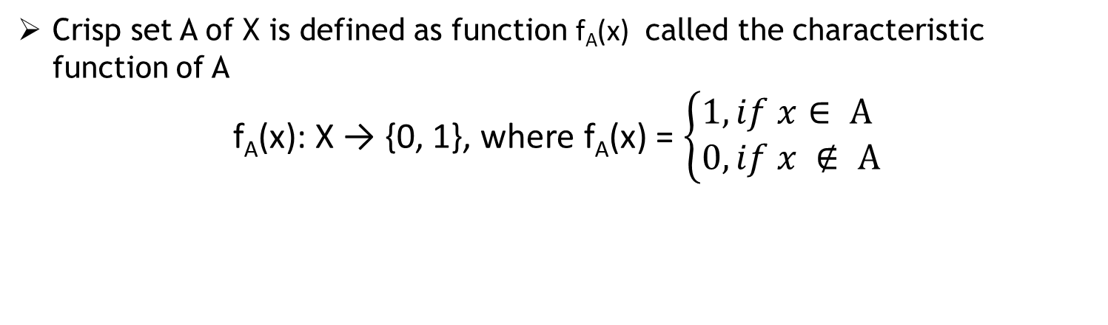
Crisp and fuzzy sets
Crisp set A of X is defined as function f_{A}(x) called the characteristic function of A
f_{A}(x): X → {0, 1}, where f_{A}(x) = $\left\{\begin{aligned}1, if x∈ A \\ 0, if x ∉ A\end{aligned}\right.$
In the fuzzy theory, fuzzy set A of universe X is defined by function µA(x) called the membership function of set A
µ_{A}(x): X → [0, 1], where µ_{A}(x) = 1 if x is totally in A;
µ_{A}(x) = 0 if x is not in A;
0 < µ_{A}(x) < 1 if x is partly in A
For any element x of universe X, membership function µ_{A}(x) equals the degree to which x is an element of set A. This degree, a value between 0 and 1, represents the degree of membership, also called membership value, of element x in set A.

Slide 8
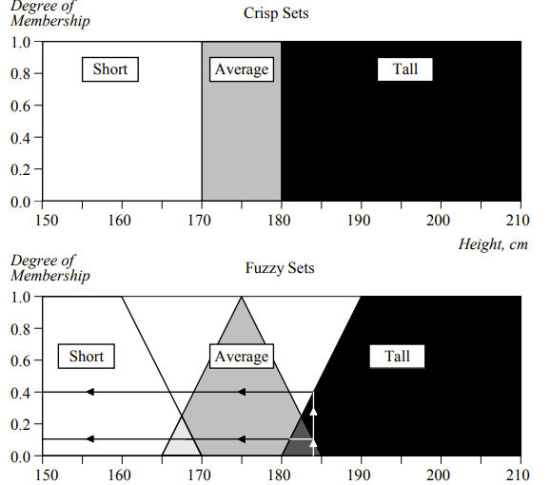
Crisp and fuzzy sets

Slide 9
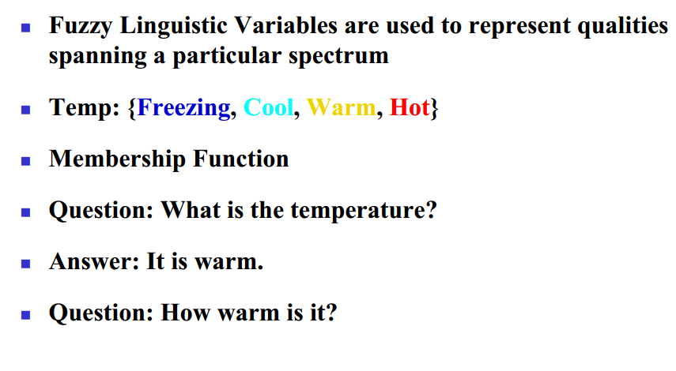
Fuzzy linguistic variables

Slide 10
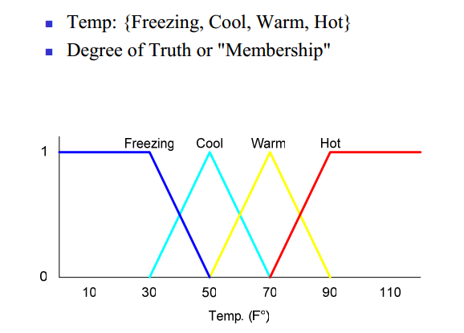
Membership functions

Slide 11
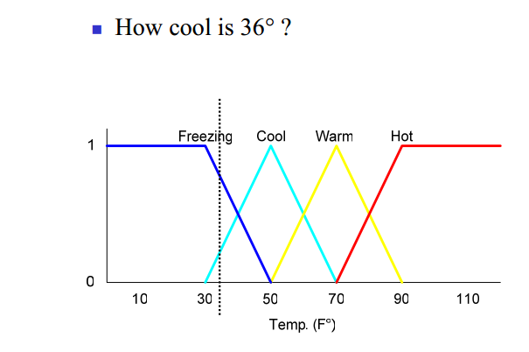
Membership functions

Slide 12
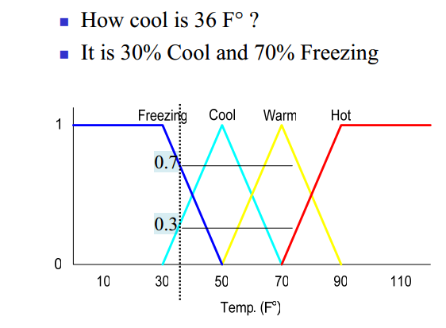
Membership functions

Slide 13
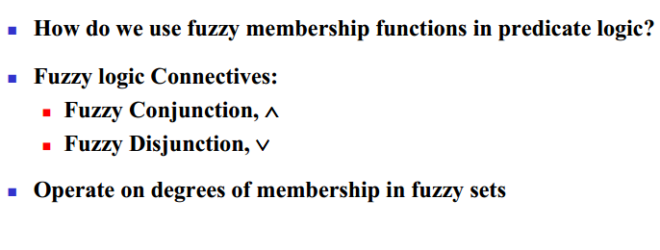
Fuzzy Rules

Slide 14
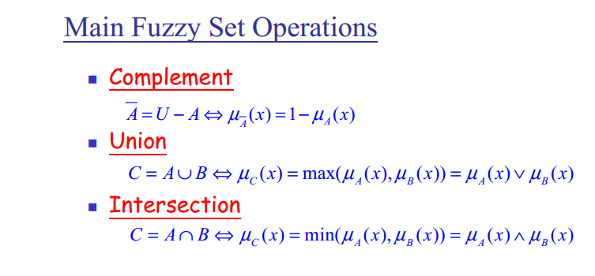
Fuzzy Rules

Slide 15
Example: Fuzzy Conjunction
Calculate A∧B given that A is .4 and B is 20

Slide 16
Example: Fuzzy Conjunction
Calculate A∧B given that A is .4 and B is 20
0.7
Determine degrees of membership:
A = 0.7

Slide 17
Example: Fuzzy Conjunction
Calculate A∧B given that A is .4 and B is 20
0.9
0.7
Determine degrees of membership:
A = 0.7 B = 0.9

Slide 18
Example: Fuzzy Conjunction
Calculate A∧B given that A is .4 and B is 20
0.9
0.7
Determine degrees of membership:
A = 0.7 B = 0.9
Apply Fuzzy AND
A∧B = min(A, B) = 0.7

Slide 19
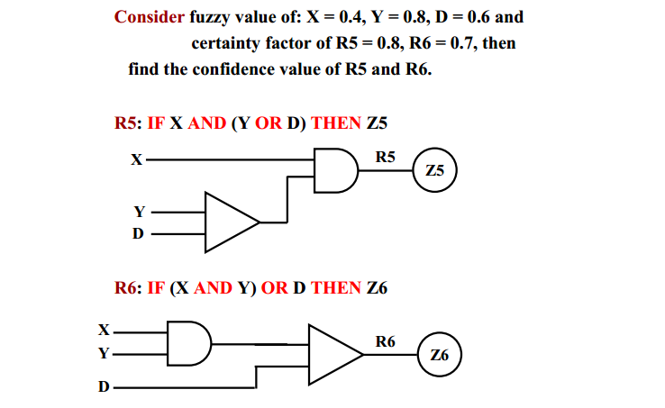
Example: Fuzzy Conjunction

Slide 20
Fuzzy Inference
Fuzzy inference can be defined as a process of mapping from a given input to an output, using the theory of fuzzy sets.
The most commonly used fuzzy inference technique is the so-called Mamdani method.
Mamdani fuzzy model has been proposed in 1975 by E. Mamdani [14]. It is one of the first fuzzy systems and one of the most used ones.

Slide 21
Mamdani Fuzzy Model
The Mamdani-style fuzzy inference process is performed in four steps:
1) Fuzzification: is to take the crisp inputs and determine the degree to which these inputs belong to each of the appropriate fuzzy sets.
2) Rule evaluation: is to take the fuzzified inputs, and apply them to the antecedents of the fuzzy rules.
3) Aggregation: is the process of unification of the outputs of all rules.
4) Defuzzification: the final output of a fuzzy system has to be a crisp number. The input for the defuzzification process is the aggregate output fuzzy set and the output is a single number.

Slide 22
Example
Rule1: IF temperature is low AND wind blowing is strongly
THEN weather is cold
Rule2: IF temperature is medium OR wind blowing is gentle
THEN weather is average
Rule3: IF temperature is high OR wind blowing is gentle
THEN weather is hot
The input data are: temperature value is 25 degrees and the wind speed is 35 km/h.

Slide 23
Linguistic variables
Rule1: IF temperature is low AND wind blowing is strongly
THEN weather is cold
Rule2: IF temperature is medium OR wind blowing is gentle
THEN weather is average
Rule3: IF temperature is high OR wind blowing is gentle
THEN weather is hot
The input data are: temperature value is 25 degrees and the wind speed is 35 km/h.

Slide 24
Linguistic values
Rule1: IF temperature is low AND wind blowing is strongly
THEN weather is cold
Rule2: IF temperature is medium OR wind blowing is gentle
THEN weather is average
Rule3: IF temperature is high OR wind blowing is gentle
THEN weather is hot
The input data are: temperature value is 25 degrees and the wind speed is 35 km/h.

Slide 25
Fuzzy Rules
Temperature : x
fuzzy sets: low, medium, high: A1, A2, A3
universe of discourse: X
• Wind: y
fuzzy sets: strongly and gentle: B1, B2
universe of discourse: Y
• Weather: z
fuzzy sets: cold, average and hot: C1, C2, C3
universe of discourse: Z
Rule1:
IF x is A1 AND y is B1
THEN z is C1
Rule2:
IF x is A2 OR y is B2
THEN z is C2
Rule3:
IF x is A3 OR y is B2
THEN z is C3

Slide 26
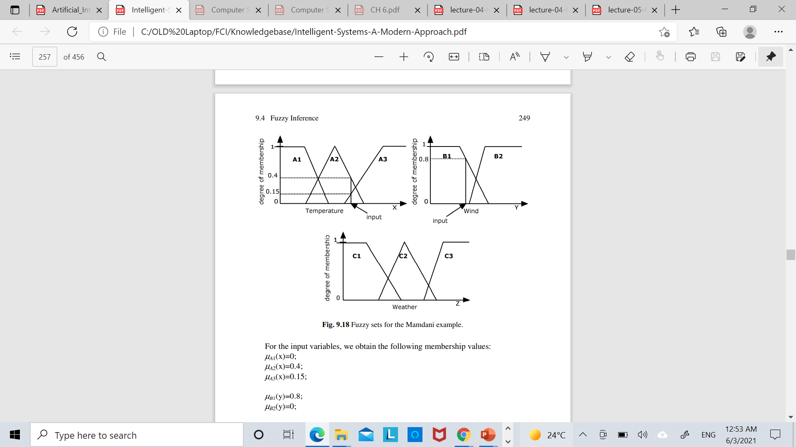
Step 1. Fuzzification
25
35
µA1(x)=0;
µA2(x)=0.4;
µA3(x)=0.15;
µB1(y)=0.8;
µB2(y)=0;

Slide 27
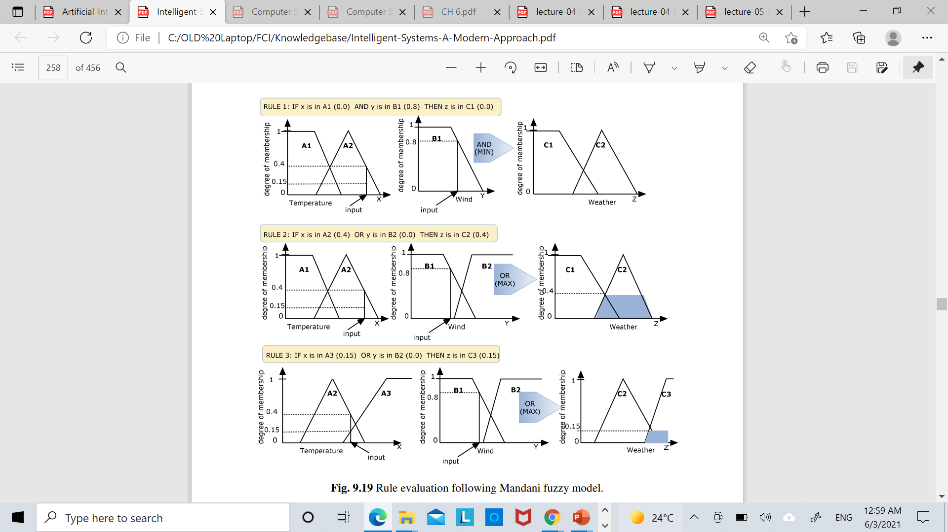
Step 2. Rules evaluation

Slide 28
Step 2. Rules evaluation

Slide 29
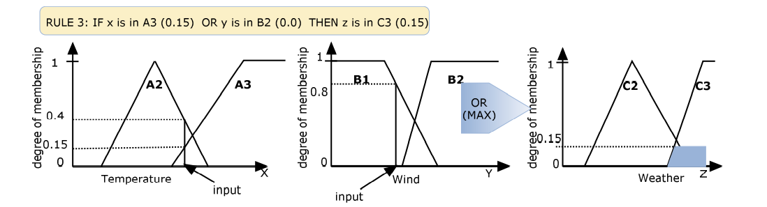
Step 2. Rules evaluation

Slide 30
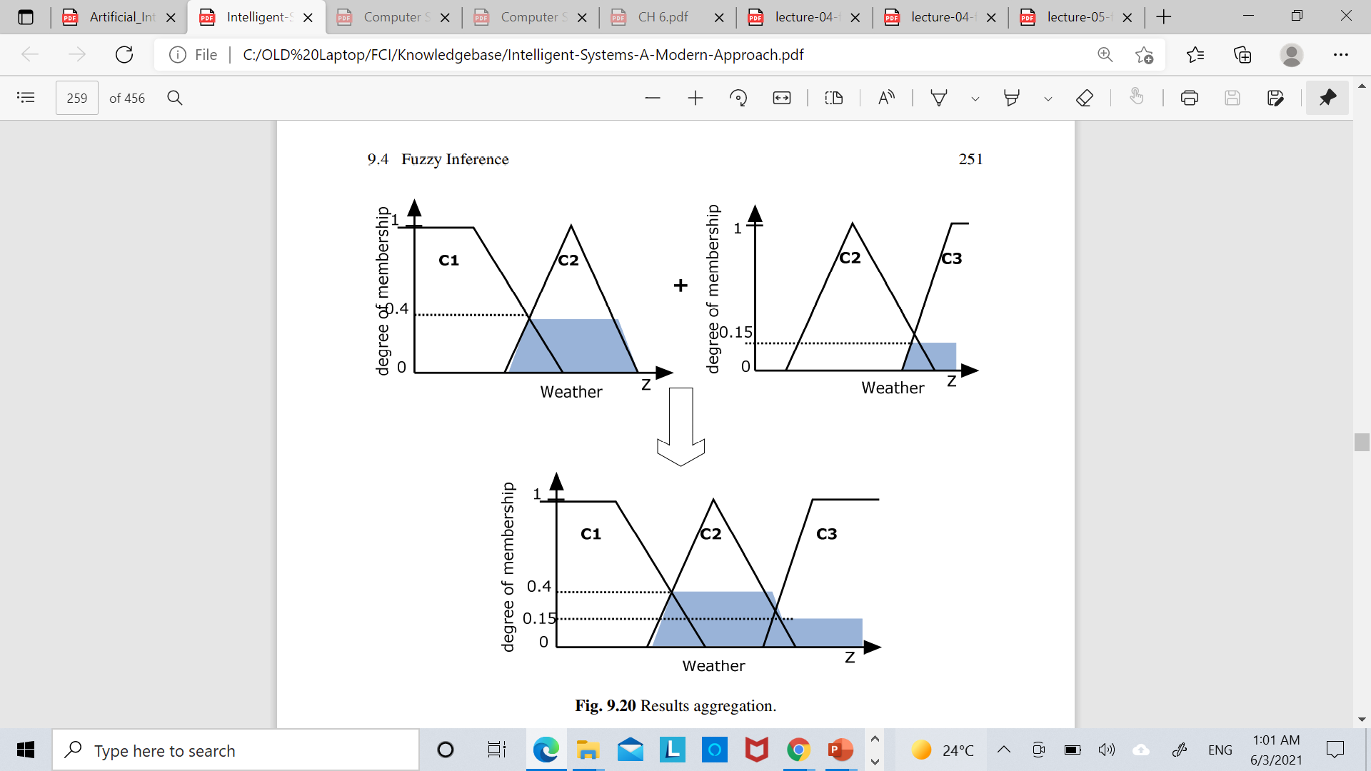
Step 3. Results aggregation
We have obtained the following results:
µC1(z)=0; µC2(z)=0.4; µC3(x)=0.15.

Slide 31
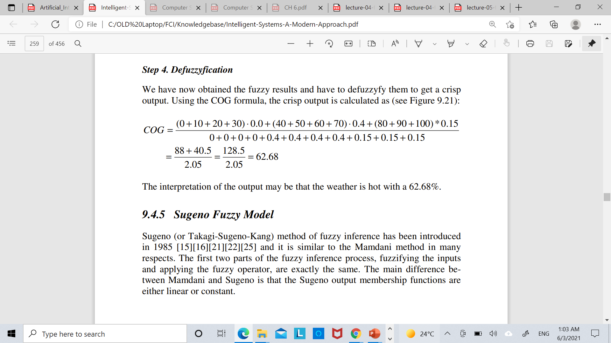
Step 4. Defuzzification (Centre of Gravity)
10
20
30
40
50
60
70
80
90
100

Slide 32
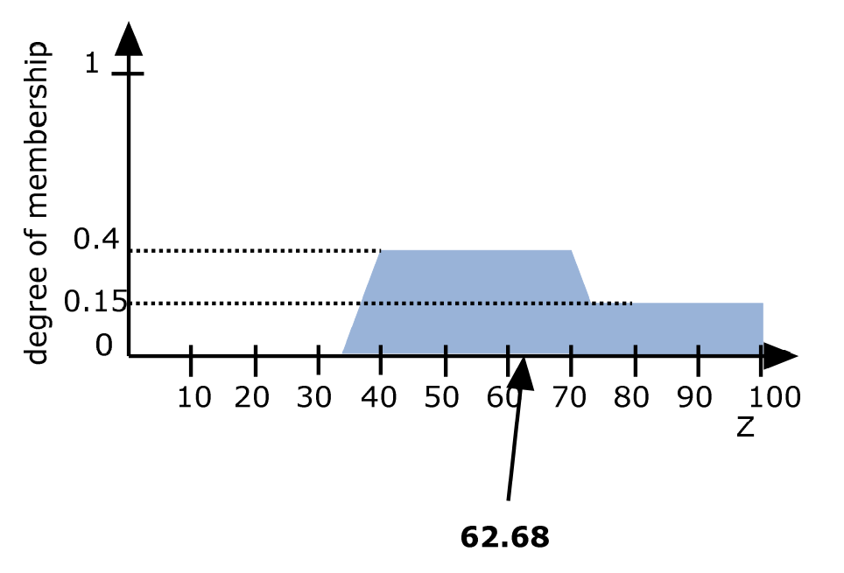
Step 4. Defuzzification (Centre of Gravity)

